Slide 1



Large Scale Visual Recognition Challenge 2017 (ILSVRC2017)
BDAT Object Detection
Team Name: BDAT
Speaker: Jiankang Deng
Jiangsu Key Laboratory of Big Data Analysis Technology (B-DAT)
Nanjing University of Information Science & Technology (NUIST)

Slide 2
Submission Brief
  Object detection with provided training data
  Rank 1# (mAP: 0.732227)
  Object detection with additional training data
  Rank 1# (mAP: 0.731613)
  Object classification and localization with provided training data
  Rank 3# (LOC error: 0.081392) NUS-Qihoo_DPNs: 0.062263
  Rank 4# (CLS error: 0.029620) WMW_ Momenta : 0.022510
  Network Engineering Level:
  NUS-Qihoo(2.74%)→Trimps-Soushen (2.481%) → Momenta(2.251%)
  Object classification and localization with additional training data
  Rank 2# (LOC error: 0.087533) NUS-Qihoo_DPNs: 0.061941
  Rank 2# (CLS error: 0.029970) NUS-Qihoo_DPNs: 0.027130

Slide 3
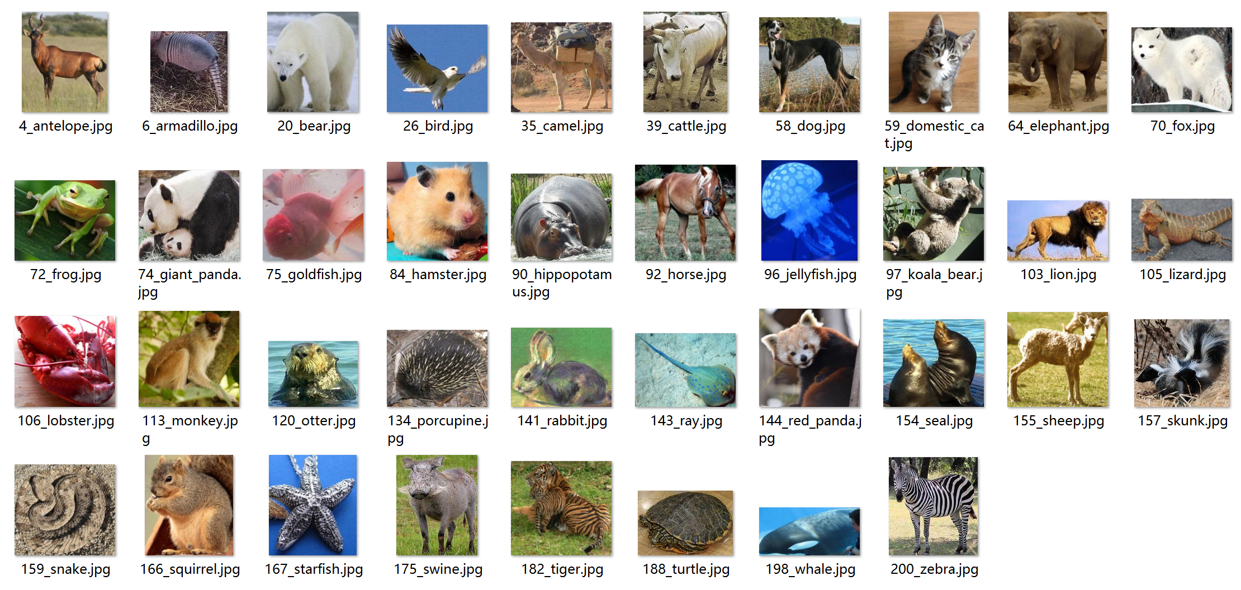
DET Dataset
animal

Slide 4
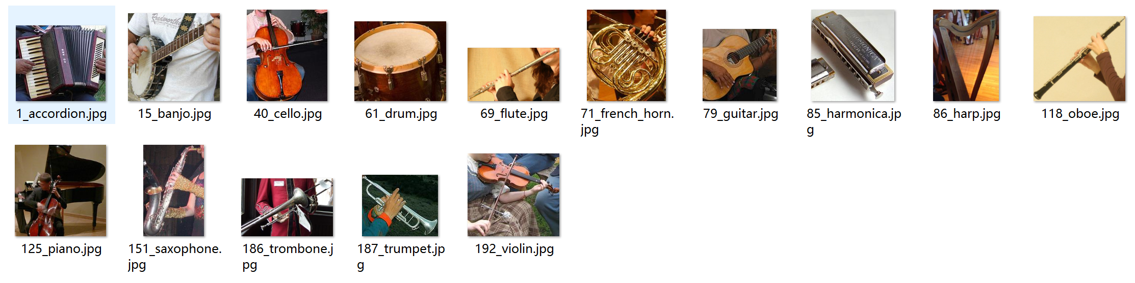
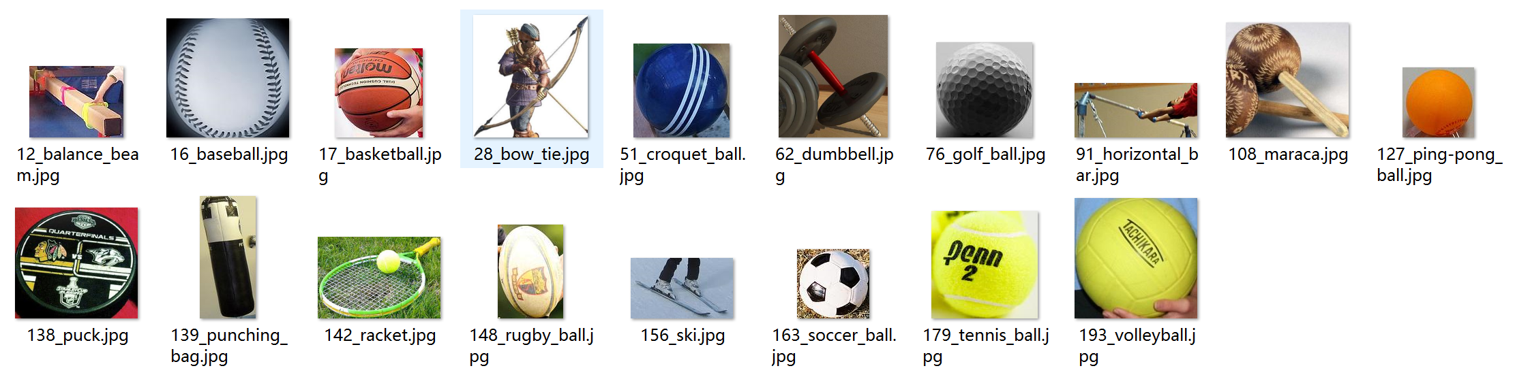
DET Dataset
music instrument
sport

Slide 5
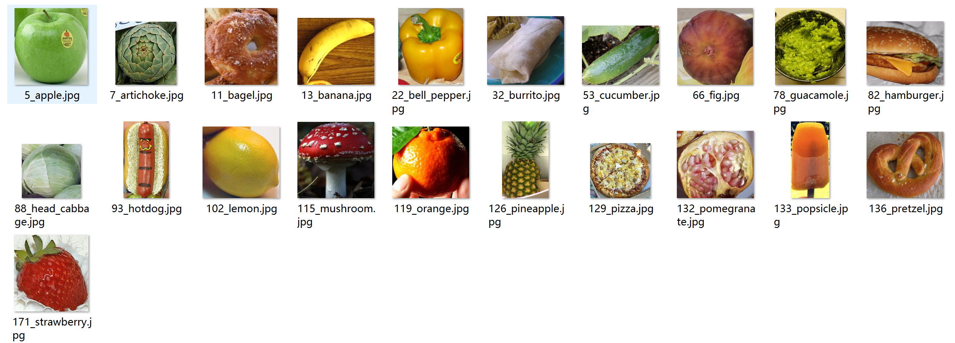
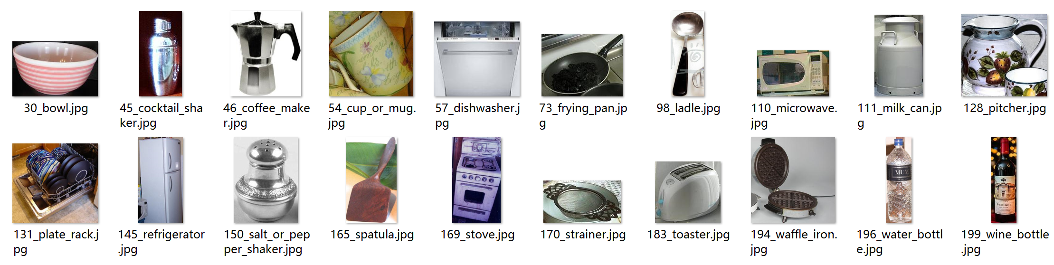
DET Dataset
food
kitchen

Slide 6
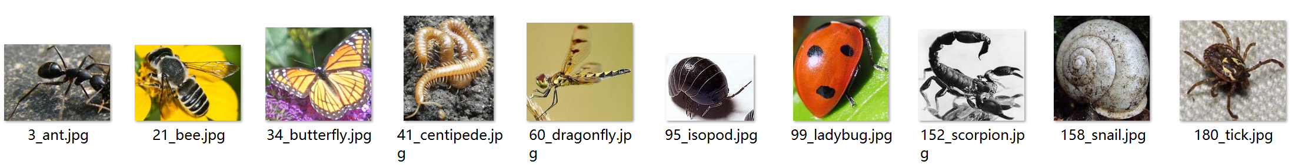
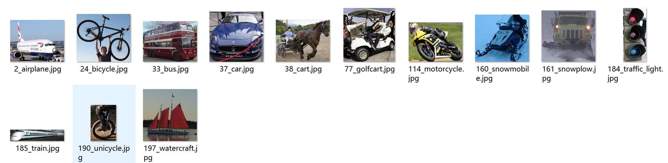
DET Dataset
insect
vehicle

Slide 7
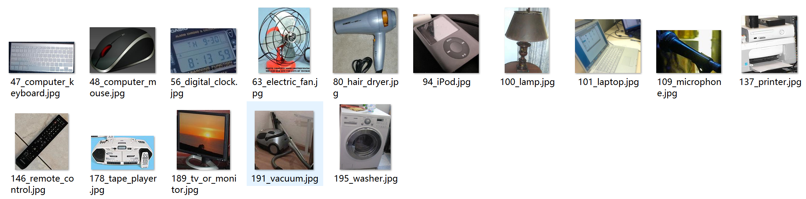
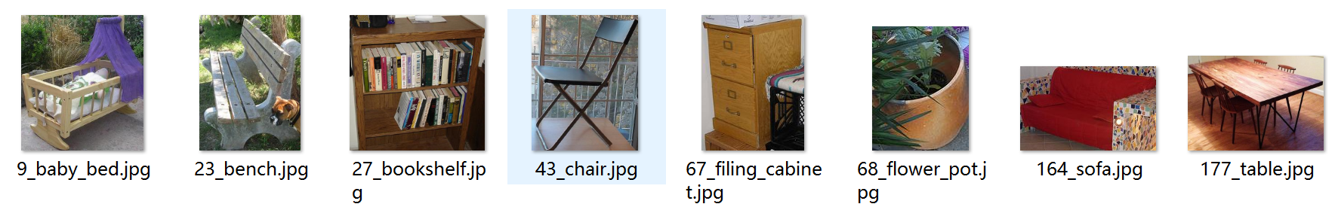
DET Dataset
appliance
furniture

Slide 8
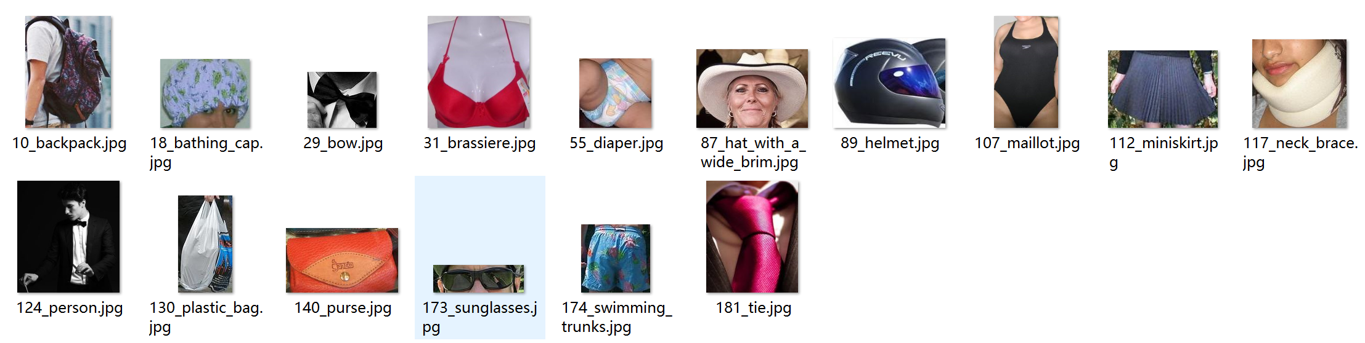
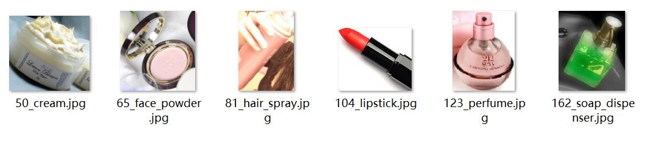
DET Dataset
accessory
cosmetic

Slide 9
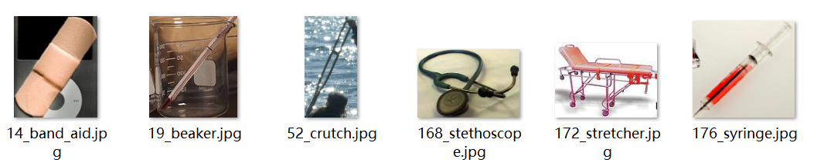
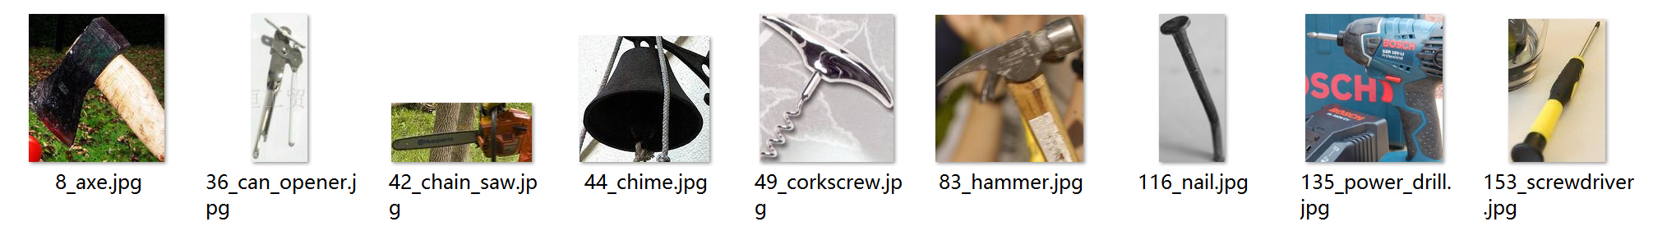
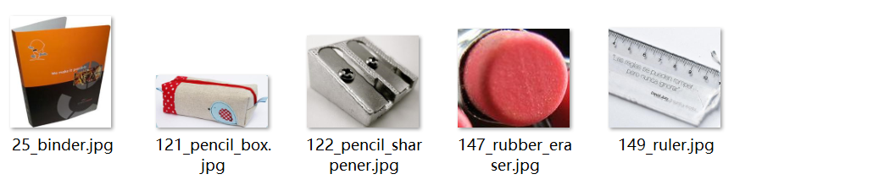
DET Dataset
medical appliances
tool
stationary

Slide 10
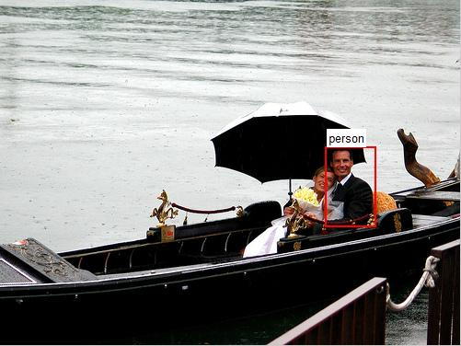
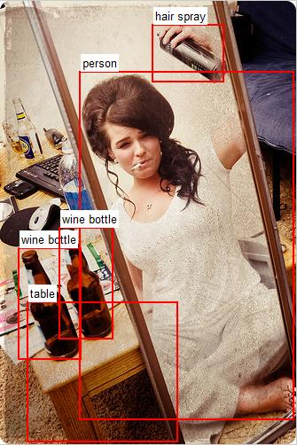
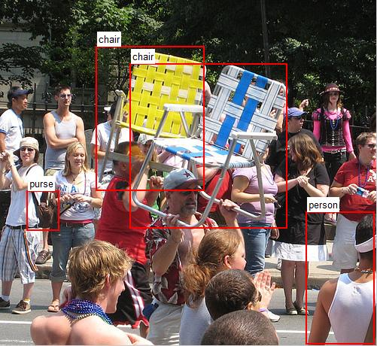
DET Label Observation
Notes:
Miss annotation
Left top person，watercraft
Left bottom person，sunglasses，hat_with_a_wide_brim,
Right coumuter_mouse, Computer_keyboard, wine_bottle, table

Slide 11
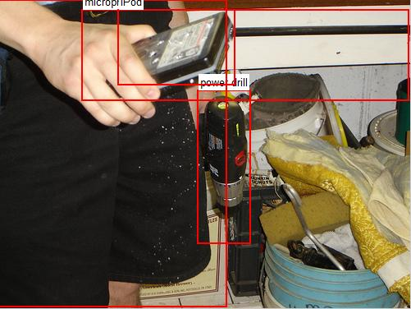
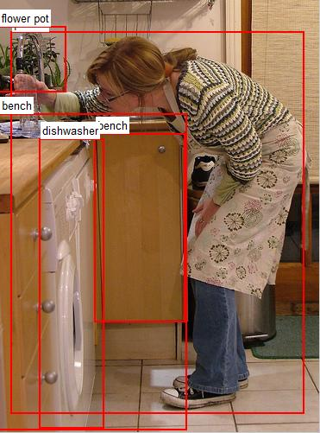
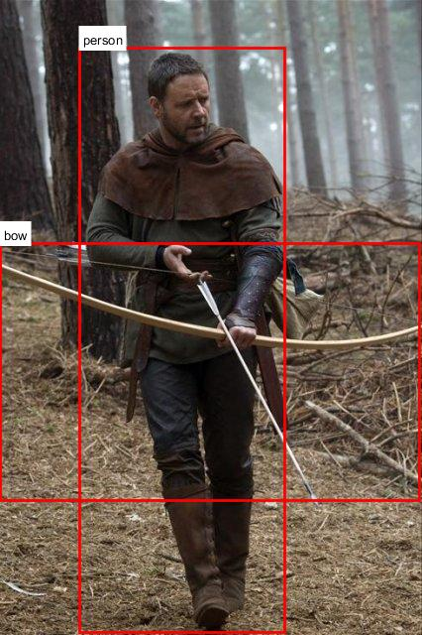
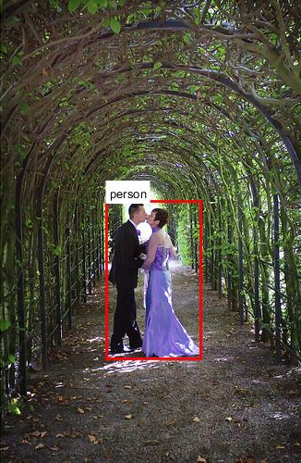
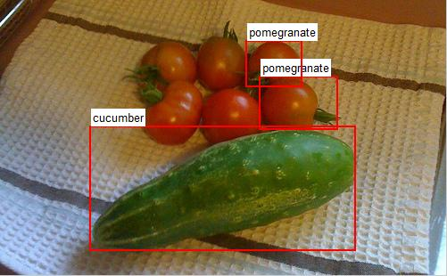
DET Label Observation
Notes:
Wrong annotation
Left top --->microphone
Left bottom tomato--->pomegranate
Right washer---> Dishwasher，---> bench
Inaccurate bounding box
Bow
Person

Slide 12
DET Dataset Observation
Dataset | Train | Validation | Test
Image Num | 456,567 | 20,121 | 65500
Instance Num | 478,807 | 55,502
Min images Num | 461
Max images Num | 67,513
Min instance Num | 502 | 31
Max instance Num | 70,626 | 12,823
Instance num/image | Set 2013: 1.20 | 2.76 | ≈3+
 | Set 2014: 2.19
Challenge 1:
Density gap between train and val/test.
Challenge 2:
Unbalanced training samples between different classes.
Challenge 3:
Inconsistent data for each class (positive/ partial positive/ negative)

Slide 13
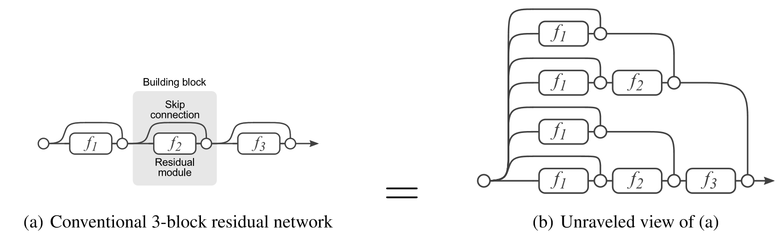
Recent Winners of DET
Self-ensemble design
[1] He K, Zhang X, Ren S, et al. Deep residual learning for image recognition.
{2] Veit A, Wilber M J, Belongie S. Residual networks behave like ensembles of relatively shallow networks.

Slide 14
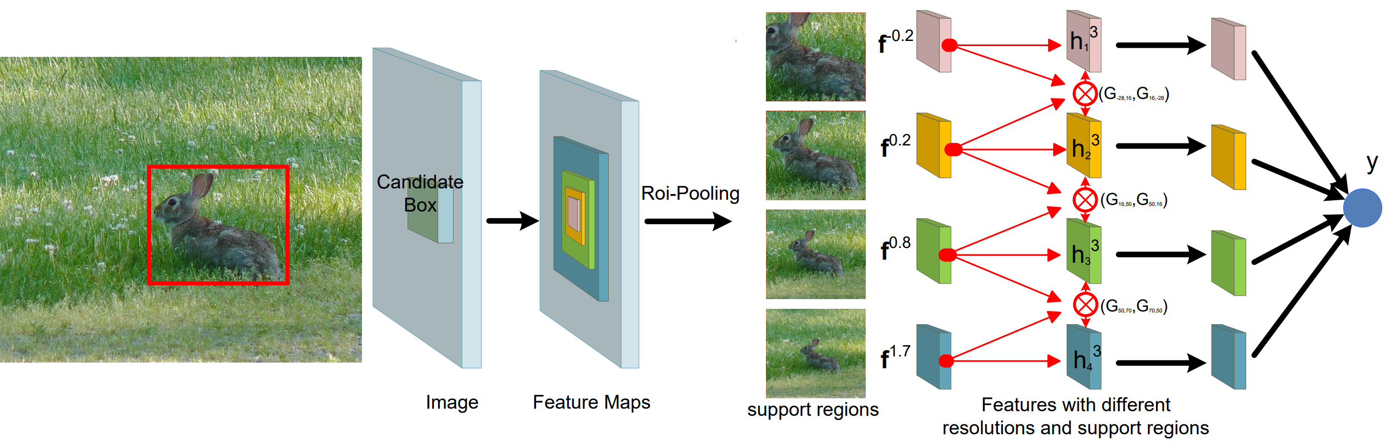
Recent Winners of DET
Self-ensemble design
Zeng X, Ouyang W, Yan J, et al. Crafting GBD-Net for Object Detection.

Slide 15
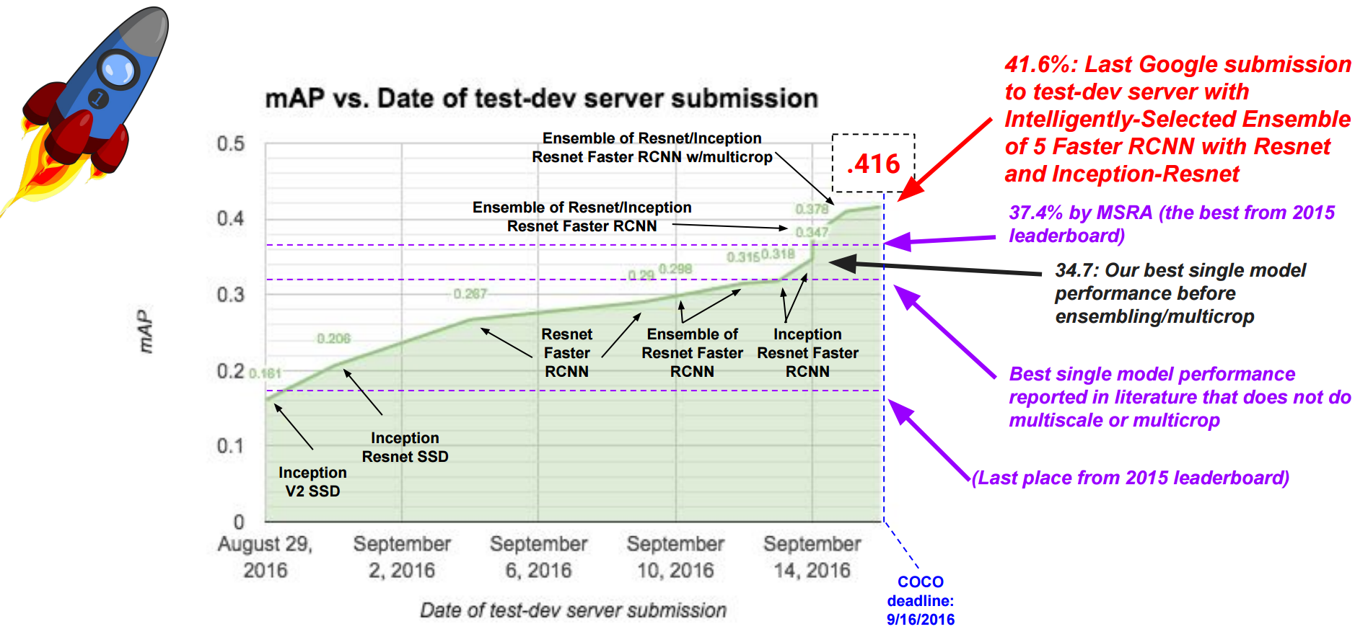
Google in COCO 2016
What can we get from Google’s experiment table?
Notes:
Network engineering + smart ensemble

Slide 16
General improvement behind object detection
Strong classifier (network engineering)
Training sample selection and balance
Hard negative mining and hard positive generation
Multi-scale
Iterative regression and box refine
Context modeling
Segmentation or Part or Landmark supervision
Model ensemble
……

Slide 17
Setup Baseline
1. Network Selection (CLS single crop top1 acc: ≈80+, top5 acc: ≈95+)
  ResNet v2 200
  ResNet 269 (CUHK 2016 DET Winner)
  Inception-ResNet-v2 (Google 2016 COCO Winner)
  Inception v4
  ResNeXt-101 (64x4d)
  Wide residual networks (WRNs)
  PolyNet
  DenseNet
  ensemble classification performance: top5 acc on the test set: 2.962
2. Training Samples
Select images with instances
Min instance number: 1500 (data augmentation)
Max instance number: 3000 (data selection, prefer multi-instance images)
Refine wrong annotation and missed annotation by pretrained ResNet 269.

Slide 18
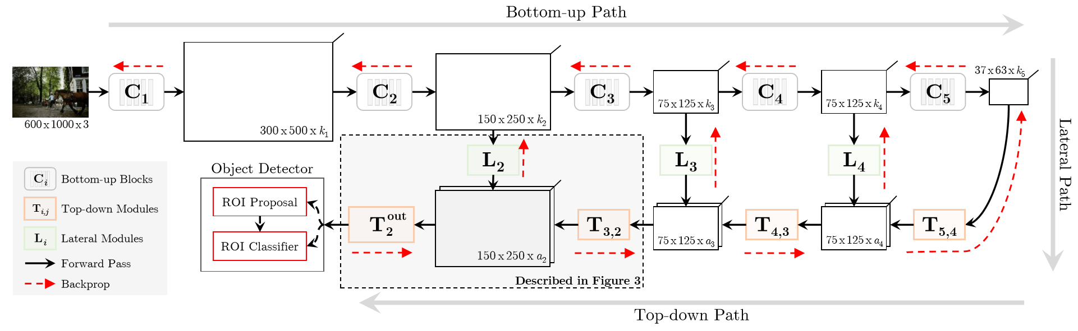
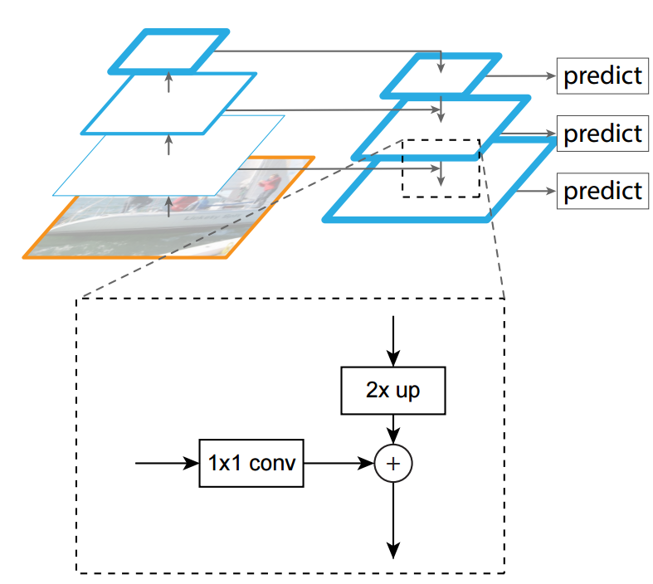
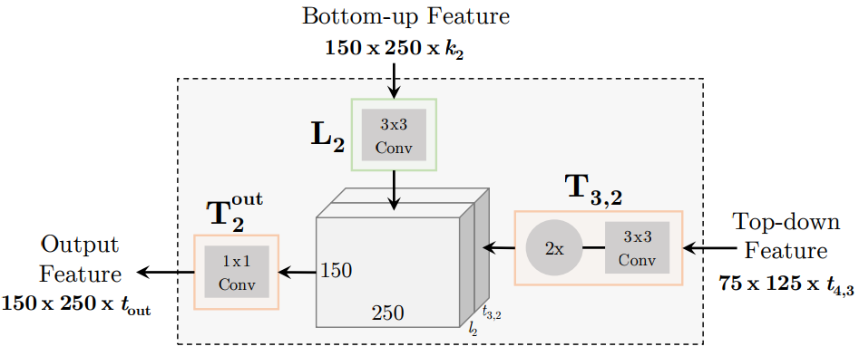
Setup Baseline
3. Scale
Bottom-up top-down design (stride ≈ 4)
[1] Tsung-Yi Lin, Piotr Dollár, Ross Girshick, Kaiming He, Bharath Hariharan, and Serge Belongie. Feature Pyramid Networks for Object Detection.
[2] Shrivastava A, Sukthankar R, Malik J, et al. Beyond skip connections: Top-down modulation for object detection.

Slide 19
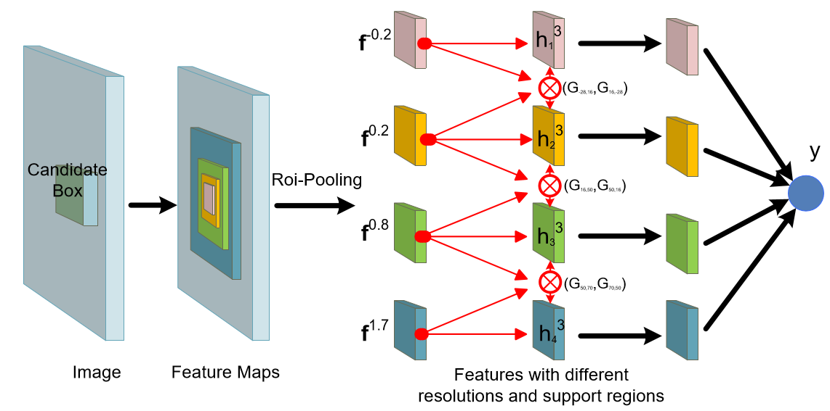
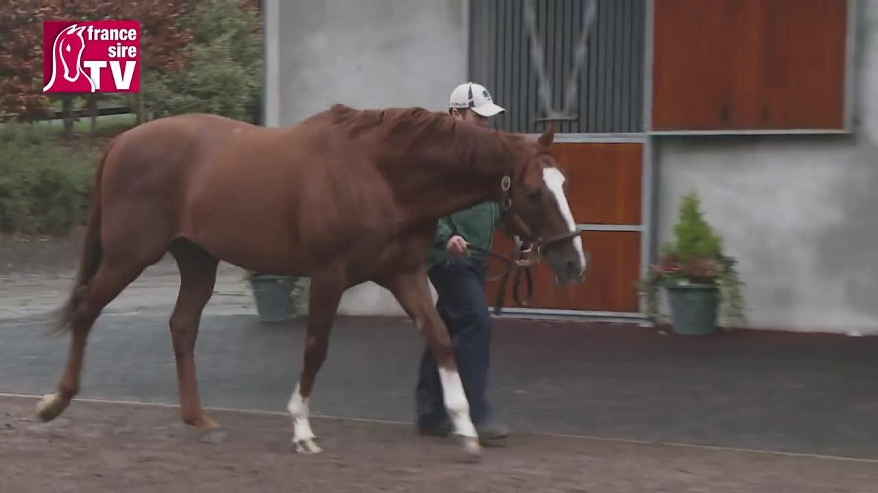
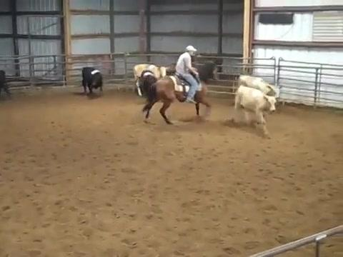
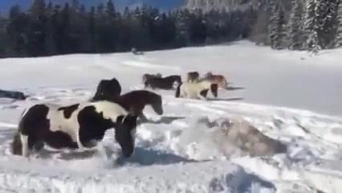

Setup Baseline
4. Context
5. Loss: box classification; box regression; crowded status

Slide 20
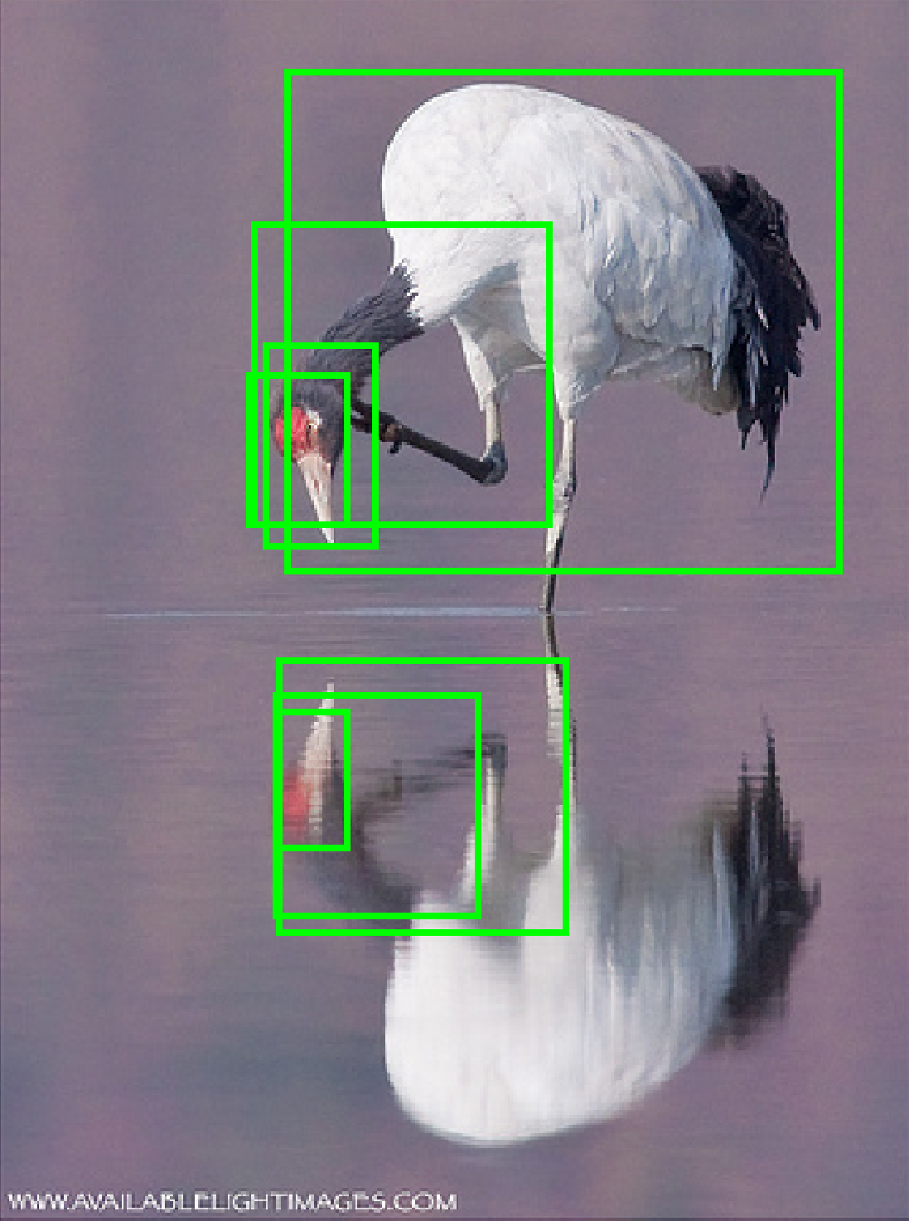
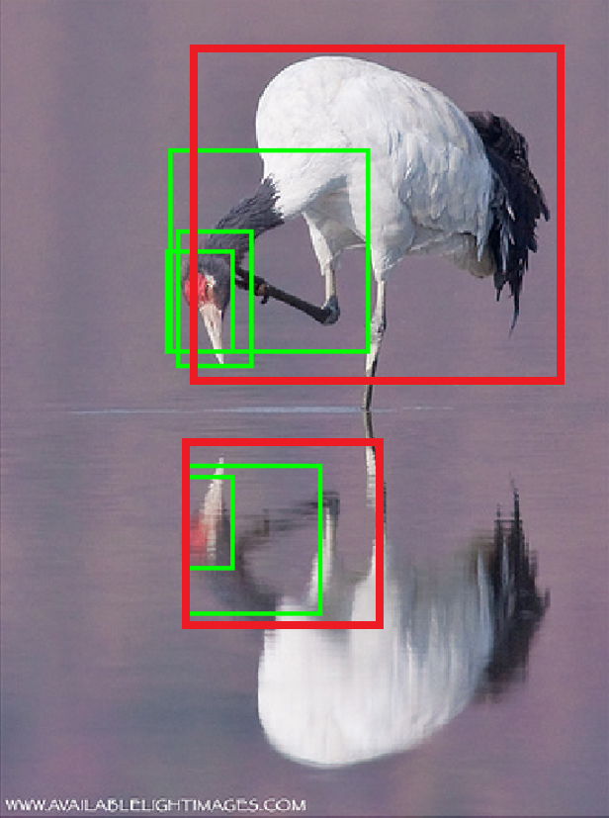
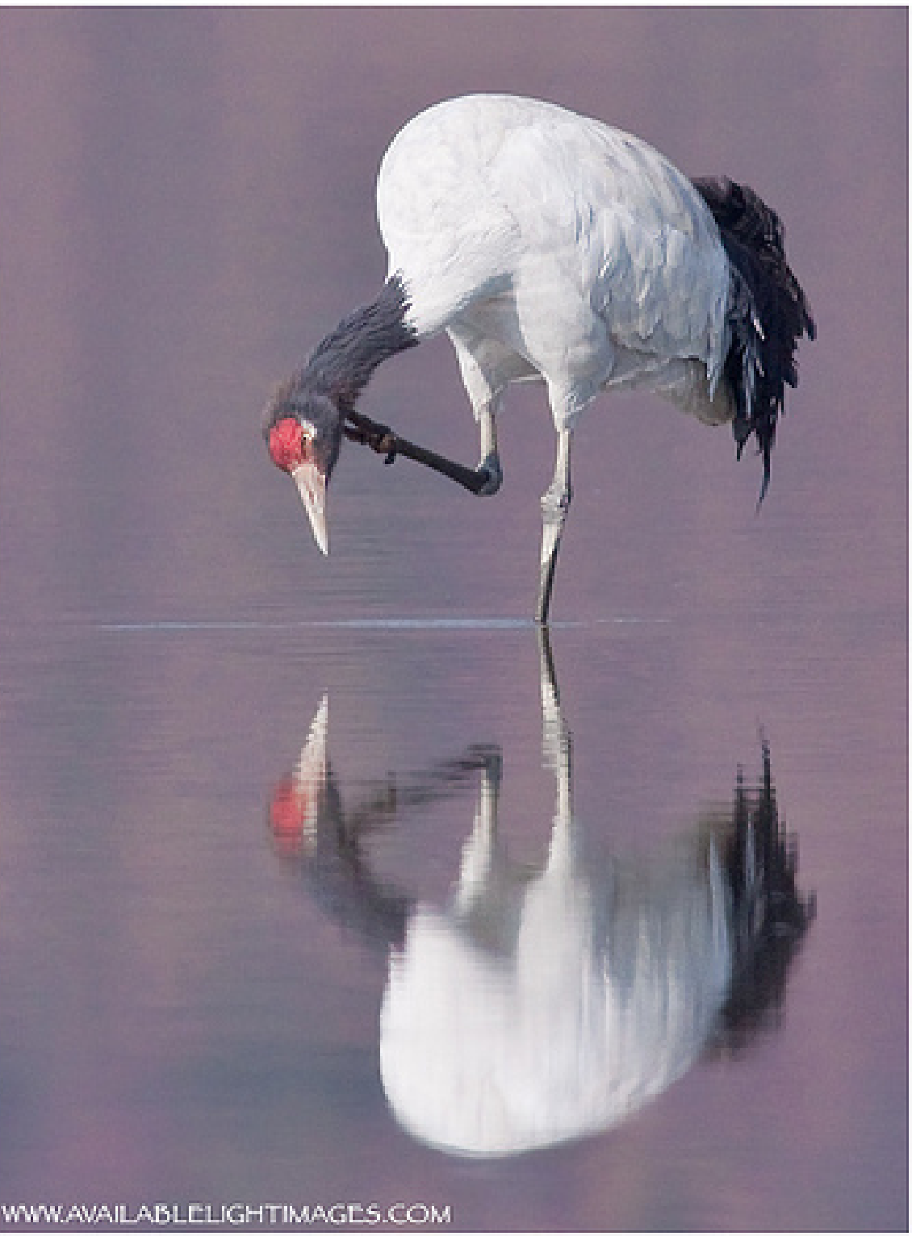
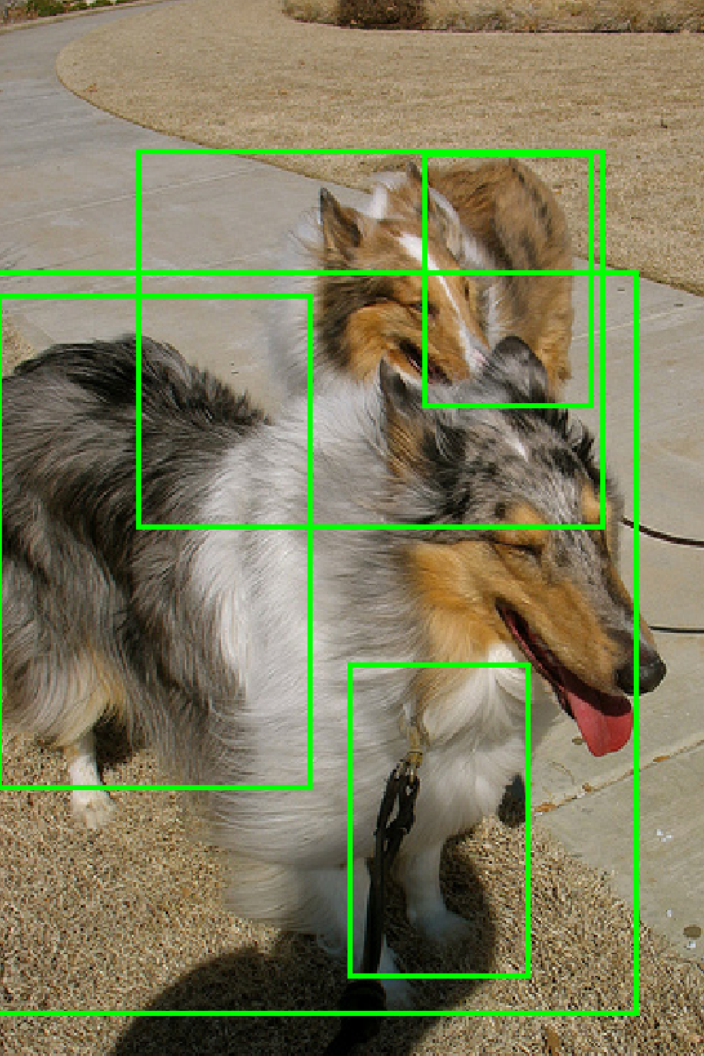
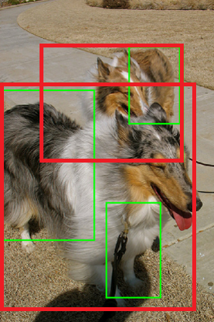
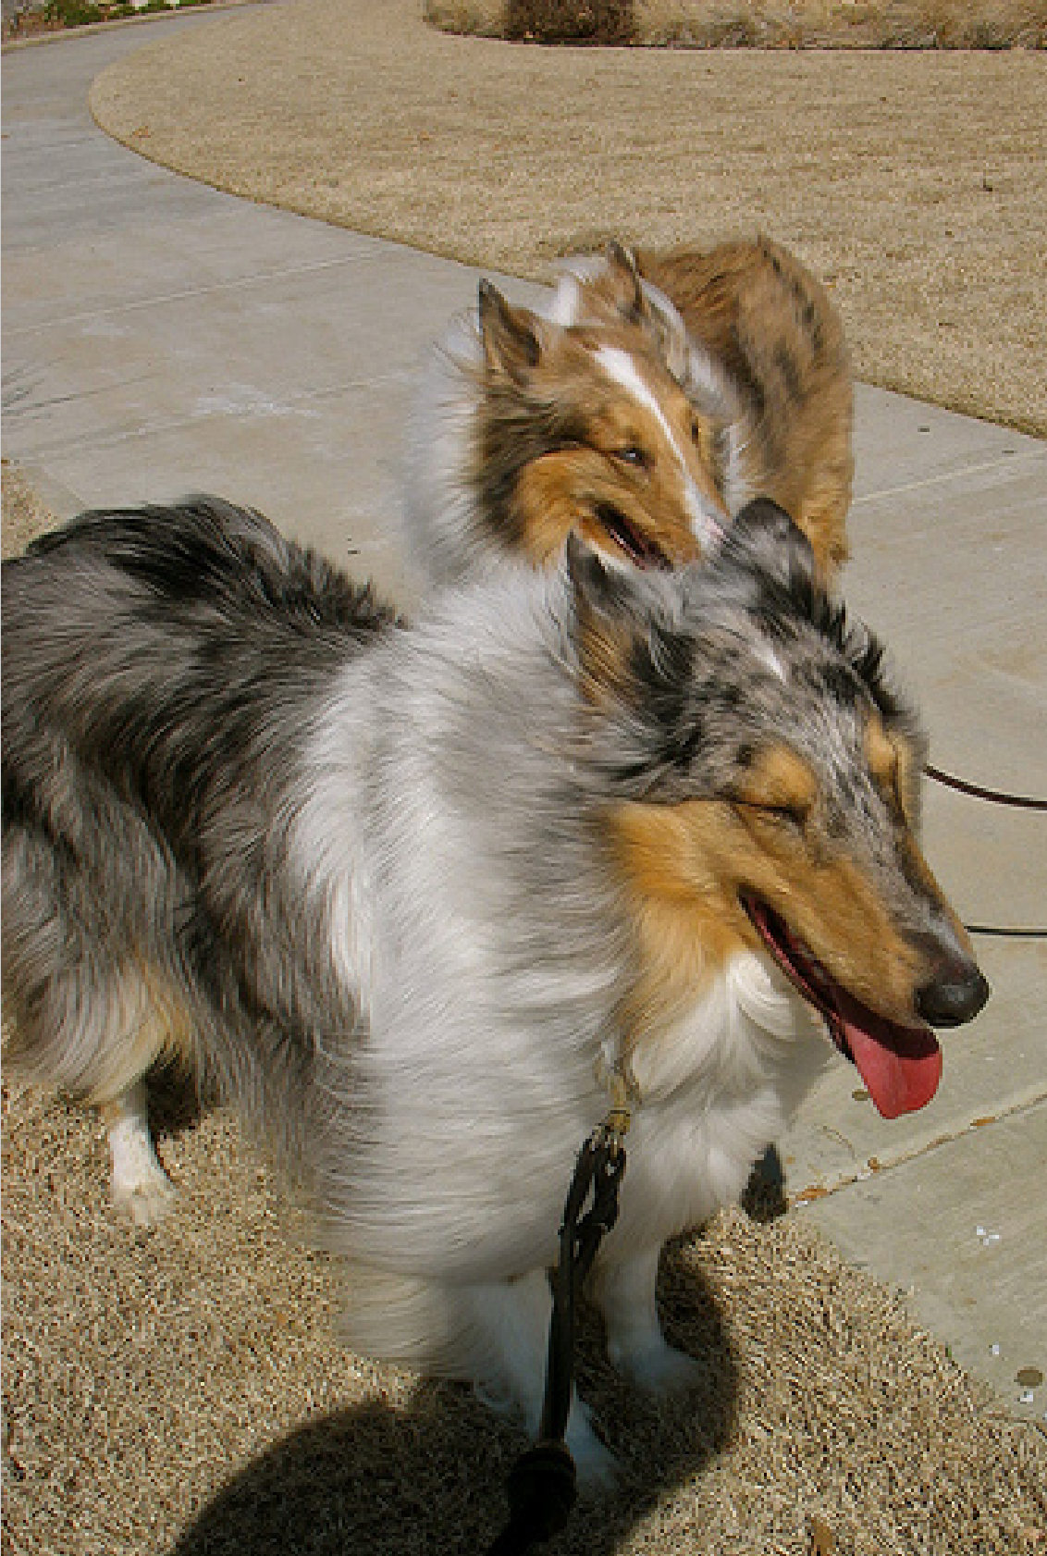
Setup Baseline
6. NMS in submission 2015
Containing
pair
(thre=0.7)
Pair wise
Combine
Notes:
In 2015,
We also pay attention to the containing relationship.
First, we find the containing pair boxes.
Then, we train regression based on this pair.
Finally, we get the combined box.
Pair-wise NMS

Slide 21
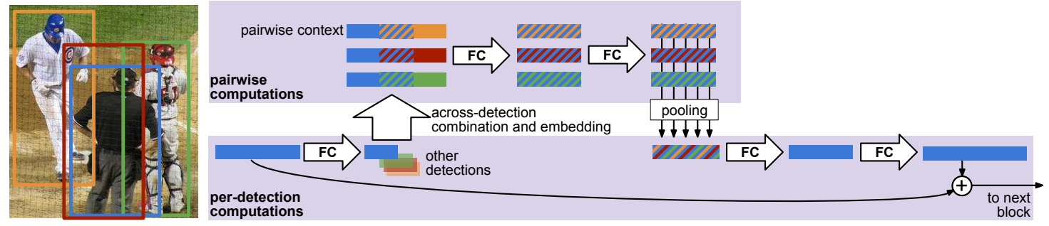
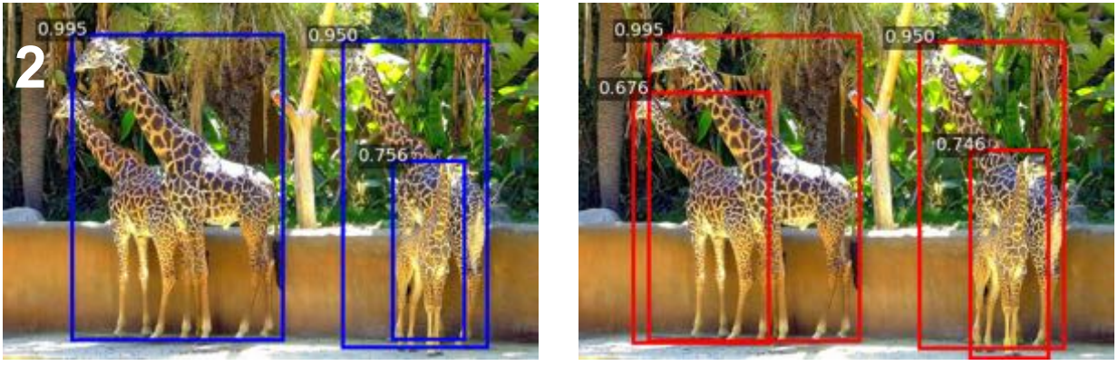
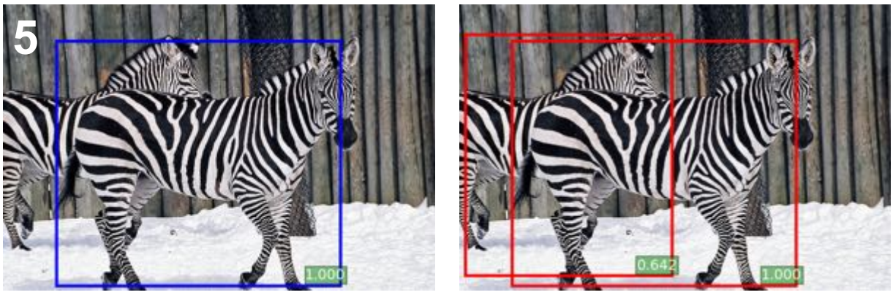
Setup Baseline
6. Recent works in NMS
[1] Jan Hosang, Rodrigo Benenson, and Bernt Schiele. Learning Non-Maximum Suppression.
[2] Navaneeth Bodla, Bharat Singh, Rama Chellappa, and Larry S. Davis. Improving Object Detection With One Line of Code.

Slide 22
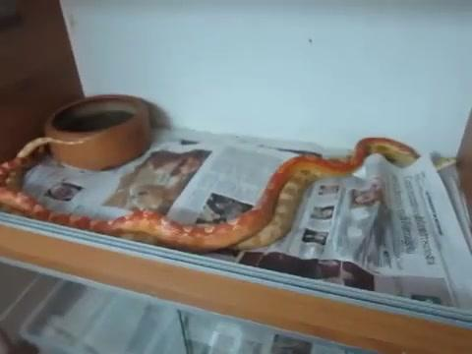
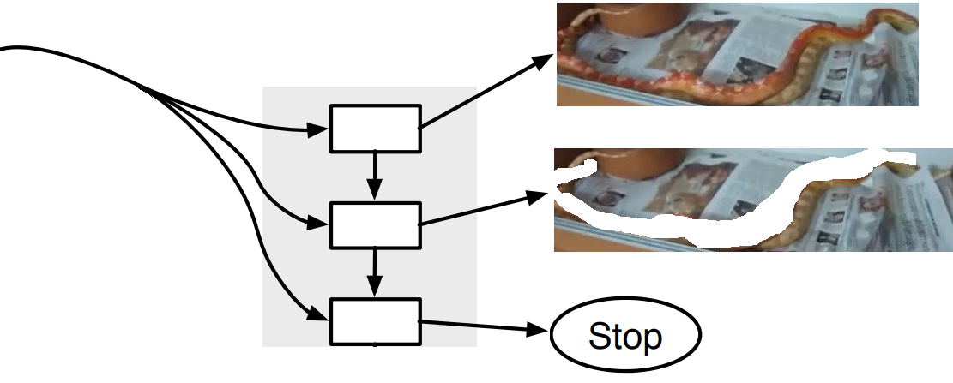
Setup Baseline
6. Recurrent NMS
Recurrent signal erase
.
[1] Yunchao Wei, Jiashi Feng, Xiaodan Liang, Ming-Ming Cheng, Yao Zhao, and Shuicheng Yan. Object Region Mining with Adversarial Erasing: A Simple Classification to Semantic Segmentation Approach.
[2] Russell Stewart, and Mykhaylo Andriluka. End-to-end people detection in crowded scenes.
Notes:
We tried some recurrent method to learn NMS. Due to the deadline limitation, this solution has not tuned to work well.
We still used pair-wise NMS in crowded regions.

Slide 23
Experimental Results
Method (incremental improvement) | mAP (%) on the val2 set
RPN with cascade region classifier (recall 95.42% @ 300 box/image) Inception-ResNet v2 + scale + context | 65.46
++ global stage-wise score re-rank by crowded status | 66.31
++ ensemble ResNet 200, ResNet 269, ResNeXt 101…… | 68.25
++ Multi-scale testing and box refinement | 69.95
++ iterative NMS on crowded region | 71.34
++ Class-wise Top-down GBD fine-turn (positive/partial positive/negative) | 73.76
Submission 2 | 72.3712 (test set)
Submission 3 (iterative NMS on crowded region instead of 0.4 IoU NMS) | 73.2227 (test set)

Slide 24
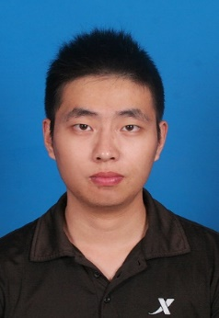
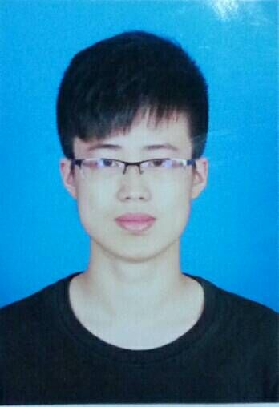
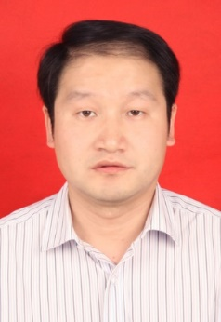
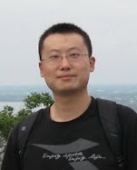
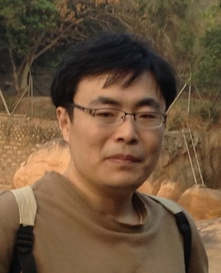
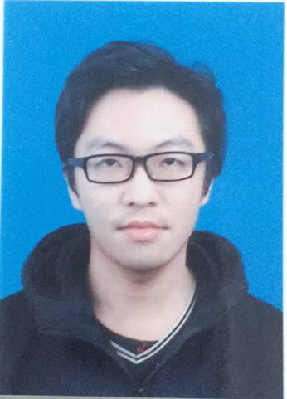
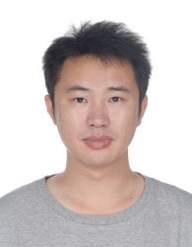






Team member
Hui Shuai
Zhenbo Yu
Qingshan Liu
Xiaotong Yuan
Kaihua Zhang
Yisheng Zhu
Guangcan Liu
Jiangsu Key Laboratory of Big Data Analysis Technology (B-DAT)
Nanjing University of Information Science & Technology (NUIST)
Jing Yang
Yuxiang Zhou
Jiankang Deng
Notes:
Thanks for the contribution made by my team members.
Great thanks for the hardware supports from Nvidia.

Slide 25

Email: jiankangdeng@gmail.com
Notes:
Thanks for your attention.
If you have any question, please send to my email. I will reply with the related details as soon as possible.

